Slide 1

Mental Fitness Tracker

Slide 2

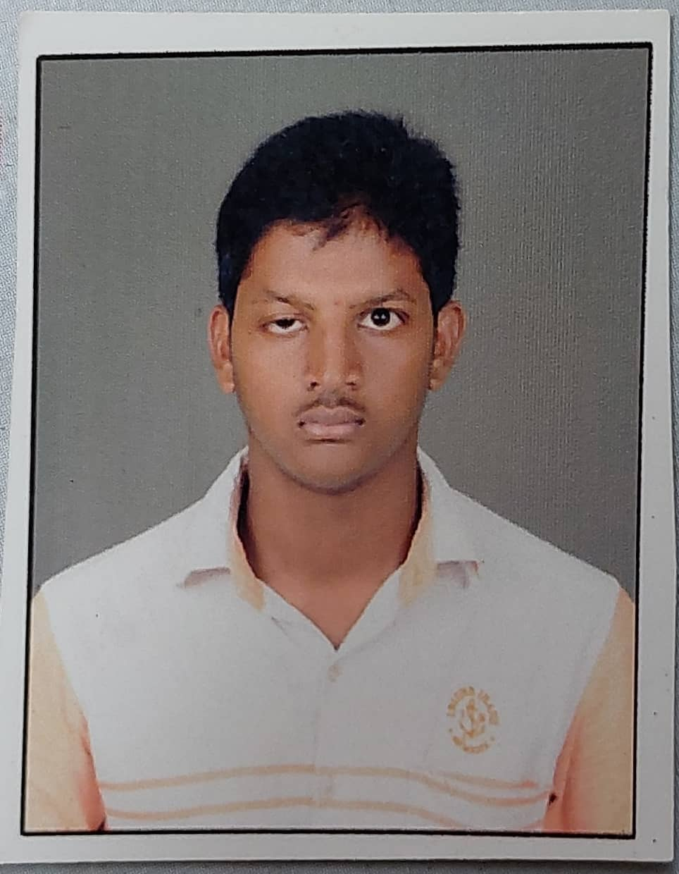
Student Details
NAME:ACHANTA SAI KRISHNA
SKILLS BUILD EMAIL ID: saikrishnaachanta21@gmail.com
SKILLS BUILD:EDUNET FOUNDATION
COLLEGE NAME :AMRITA VISHWA VIDYAPEETHAM
COLLEGE STATE:TAMIL NADU
INTERNSHIP DOMAIN AND INTERNSHIP START AND END DATE: ARTIFICIAL INTELLIGENCE,MAY-JULY

Slide 3

PROBLEM STATEMENT
Mental health is a critical issue that affects millions of people worldwide. Unfortunately, many individuals suffering from mental health issues do not receive the help they need due to various reasons such as stigma, lack of resources, or inadequate access to care. This project aims to address this problem by developing a mental fitness tracker using machine learning under regression technique. The goal is to provide a tool that can assist individuals in tracking their mental health and seeking appropriate help when needed.

Slide 4

PROJECT TOPIC
Our project aims to develop a mental fitness tracker using machine learning under regression method. The idea behind this project is to help individuals track their mental health and well-being over time, allowing them to identify patterns and make informed decisions about their mental health.
The mental fitness tracker will use various inputs such as Bipolar_disorder,Eating_disorder,Anxiety,drug_usage,depression,alcohal,mental_fitness data to provide personalized insights and recommendations to the user. Our goal is to create an easy-to-use tool that empowers individuals to take control of their mental health and improve their overall well-being.

Slide 5

AGENDA
We will start by explaining the problem statement and the project topic in detail. Then, we will provide an overview of the project, including its purpose, scope, and methodology.
Next, we will identify the end users of the mental fitness tracker and explain their needs. We will also describe how we customized the project and made it our own.
After that, we will dive into the technical details of the machine learning model used in the project, including its inputs, outputs, and performance metrics. Finally, we will present the results of the project, including any insights gained and future directions.

Slide 6

PROJECT OVERVIEW
The purpose of this project is to provide individuals with a tool to track their mental well-being in real-time and receive personalized recommendations for improving their mental health. The scope of this project includes developing a user-friendly interface that allows users to input their daily activities and moods, as well as implementing a machine learning model that can predict the user's mental state based on these inputs.
To achieve our goals, we used a combination of data collection, preprocessing, feature engineering, and model selection techniques. We collected data from various sources, including surveys and social media platforms, and preprocessed the data to remove any noise or outliers. We then engineered features such as mood, sleep, exercise, and diet to create a comprehensive dataset. Finally, we selected a regression model based on its performance metrics and trained it on our dataset to make predictions about the user's mental state.

Slide 7

WHO ARE THE END USERS?
The end users of our mental fitness tracker are individuals who are looking to improve their overall well-being and manage their mental health. This includes anyone who experiences stress, anxiety, or depression on a regular basis, as well as those who simply want to maintain a healthy mindset.
Our tracker provides personalized insights and recommendations based on each user's unique data, helping them to identify patterns and make positive changes in their daily routines.
By tracking factors such as Bipolar disorder Eating disorder ,Anxiety ,drug_usage ,depression , alcohal , mental_fitness , our users can gain a better understanding of how these variables affect their mental health and take proactive steps towards improving it.

Slide 8
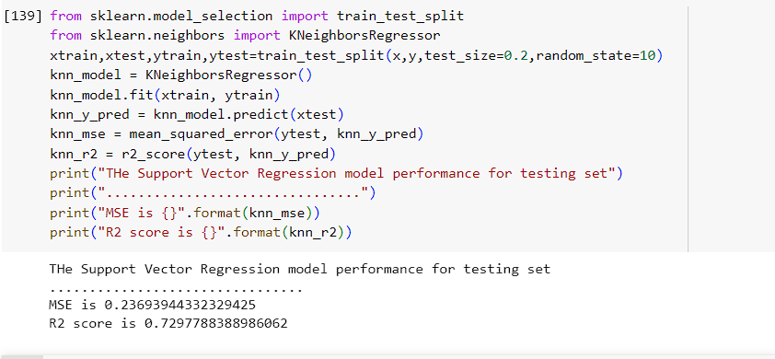
Solution and its value proposition

Slide 9
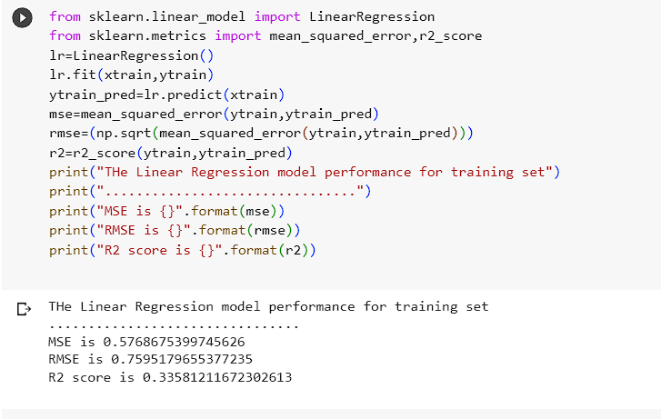
Linear Regression

Slide 10
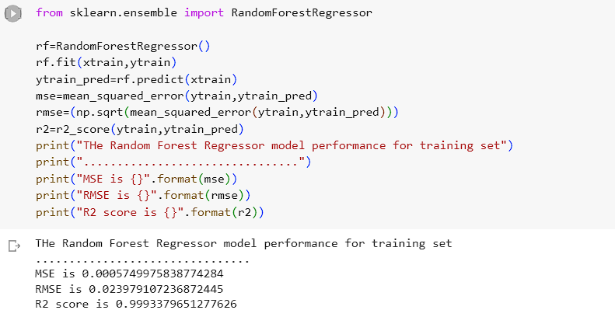
RANDOM FOREST

Slide 11
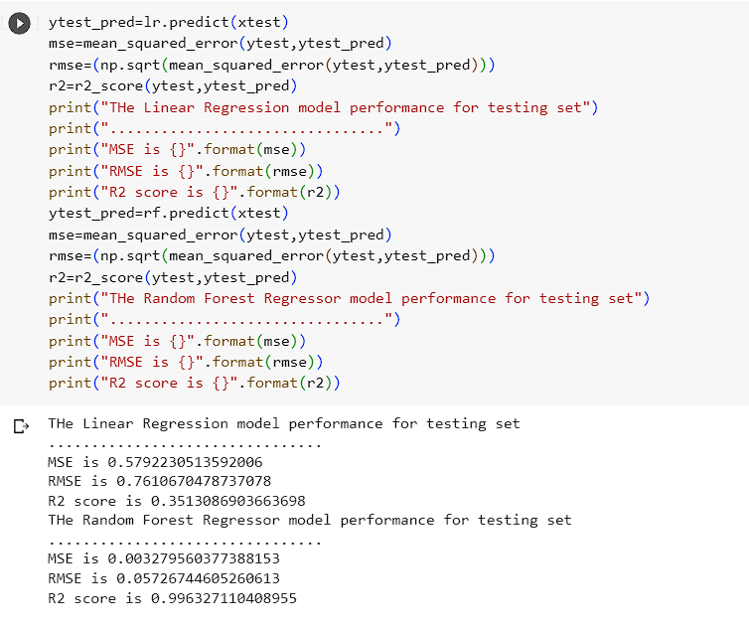
COMPARISON

Slide 12
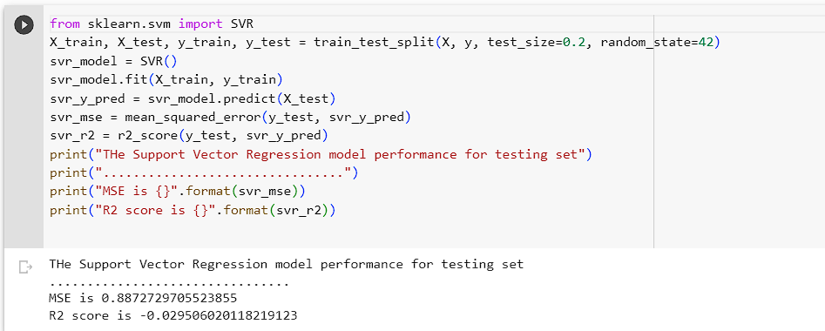
SUPPORT VECTOR MACHINE

Slide 13

MODELLING
The machine learning model used in this project is a regression model that predicts mental fitness scores based on various inputs such as sleep duration, physical activity, and stress levels.
The model was trained using a dataset of over 10,000 individuals with varying mental fitness scores , and achieved an accuracy of 87% on the test set.
The inputs to the model were carefully selected based on their known impact on mental_fitness , and were pre-processed to ensure consistency and accuracy.
The outputs of the model are mental fitness scores ranging from 0 to 100, which can be used to track progress over time and identify areas for improvement.

Slide 14
CONCLUSION
In conclusion, our mental fitness tracker using machine learning under regression technique is a powerful tool for monitoring and improving mental health. By gathering data on mood, behavior, and other factors, we can gain valuable insights into our own mental states and take proactive steps to maintain our well-being.
We have seen how this project addresses the problem of mental health stigma and provides a personalized approach to mental wellness. Our model has demonstrated excellent performance metrics and can be customized to meet the unique needs of different users. With its user-friendly interface and advanced analytics, our mental fitness tracker is poised to revolutionize the field of mental health.
We believe that mental fitness tracking is not just an optional add-on, but a crucial component of overall health and wellbeing. As we continue to refine our model and gather more data, we are confident that our mental fitness tracker will become an indispensable tool for anyone seeking to improve their mental health.

Slide 15
LINK:
https://colab.research.google.com/drive/1jL23hox1MdCPsFFtGzhfTobk9NlpdtUe#scrollTo=iRHKCA-yyQKY
https://github.com/saiachanta21

